Slide 1
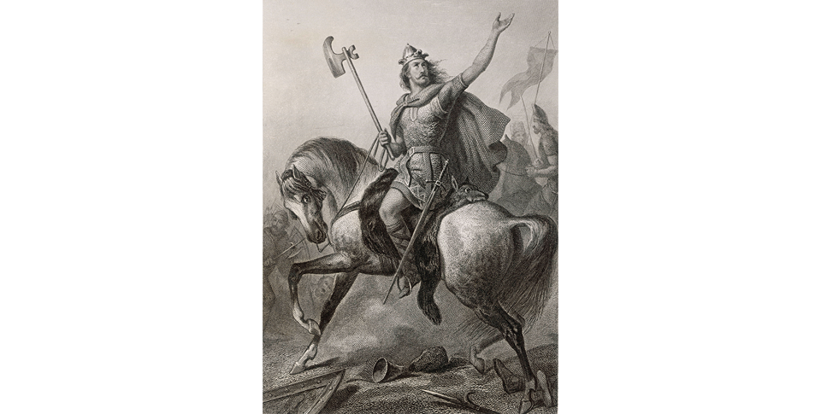
Medieval Christian Europe (330–1450)
Topic 1 Lesson 1 The Early Middle Ages

Slide 2
Medieval Christian Europe (330–1450)
Topic 1 Lesson 1 The Early Middle Ages
Learning Objectives
Summarize ways in which the Byzantine empire flourished after the decline of Rome.
Explain the impact of the fall of Rome on Western Europe.
Describe how Germanic tribes carved Europe into small kingdoms.
Explain how Charlemagne briefly reunited much of Western Europe and what happened to his empire after his death.

Slide 3
The Byzantine Empire Thrives
Constantinople Grows:
Great defensive location, guarded on 3 sides by water
Commanded key trade routes between Europe and Asia
Continued activities from Roman Heritage like chariot racing
Blending of Cultures:
Blended Ancient Greek, Roman, Christian traditions with Mediterranean customs

Slide 4
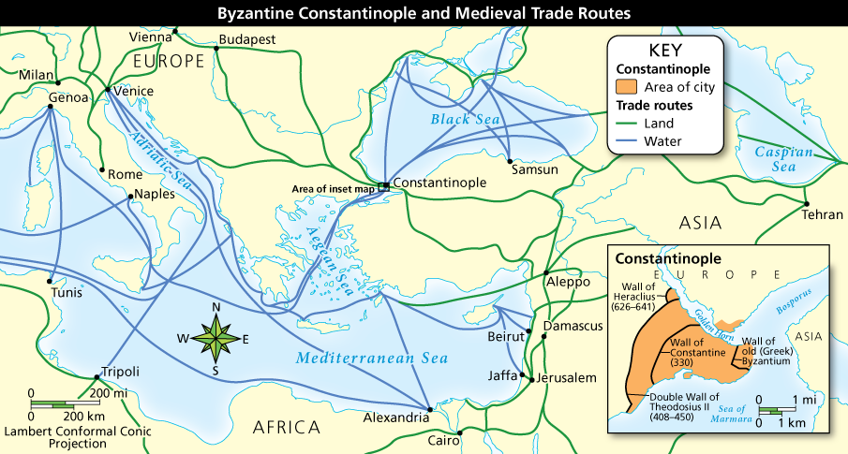
The Byzantine Empire Thrives
Major European and Asian trade routes met at Constantinople. Analyze the Maps and summarize Constantinople's protective advantages.

Slide 5
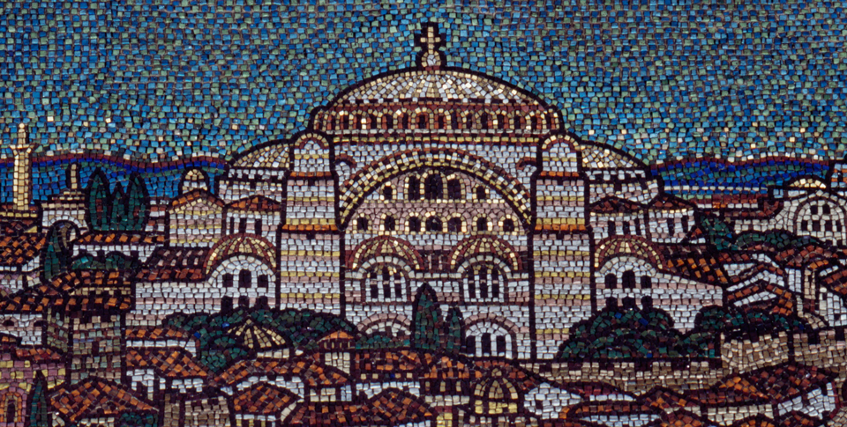
The Byzantine Empire Thrives
Constantinople, the wealthy Byzantine capital, rises behind strong walls to the great domes of the church of Hagia Sophia and beyond in this mosaic from London's Westminster Cathedral.

Slide 6
The Age of Justinian
The Byzantine empire reached its greatest size under the emperor Justinian, who ruled from 527 to 565.
Justinian was determined to revive ancient Rome by retaking lands that had been overrun by invaders.

Slide 7
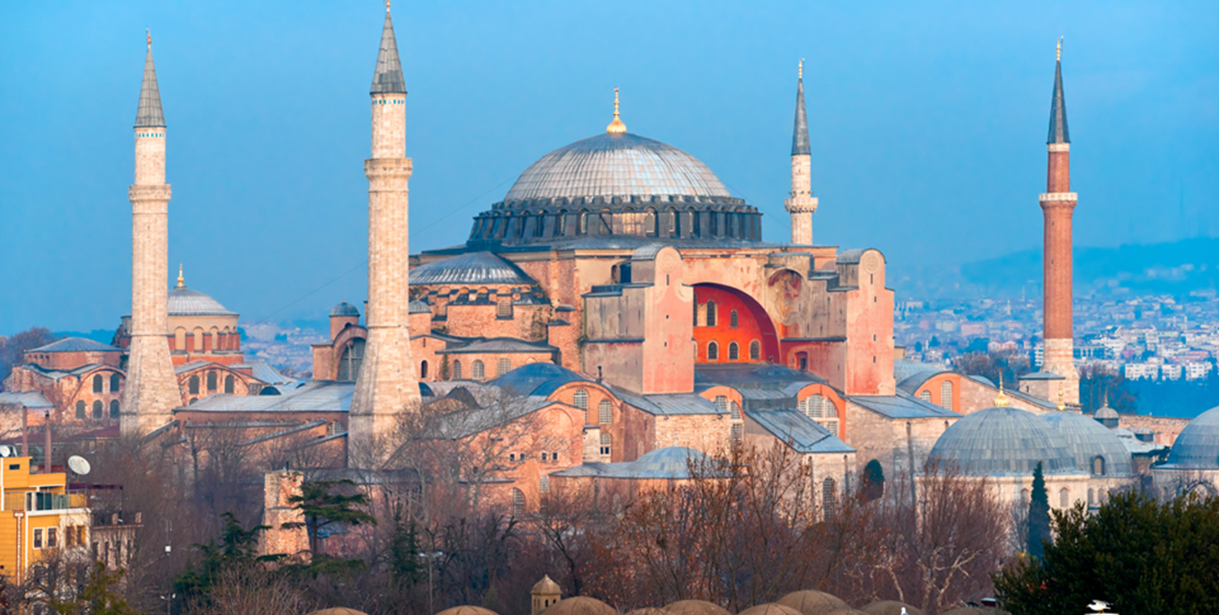
The Age of Justinian
Hagia Sophia
Called the Holy Wisdom, this cathedral is Justinian’s greatest architectural triumph

Slide 8
The Age of Justinian
Justinian’s Code and Its Impact
Early in Justinian’s rule he set up a commission to collect, revise, and organize all the laws of Ancient Rome
This is called Justinian’s Code.
By 100 AD these laws reach Western Europe which are used by monarchs to consolidate their power.
Eventually will become the basis for international law

Slide 9
Justinian Rules With Absolute Power
He is an autocrat, rules with complete authority
He also has power in the Church, deemed Christ’s co-ruler on earth
He is helped by his wife Theodora, who served as an advisor and co-ruler to Justinian. She even challenged some of his policies

Slide 10
Economic and Military Power
Byzantium had a strong economy. Peasants payed taxes, worked lands, and provided soldiers for the army
They will continue to have coin money as coin money will disappear in Western Europe
With all this money they will be able to fund a strong military
They will also have a secret weapon called Greek fire which will be used in their navy

Slide 11
The Empire Declines
The Byzantine Empire will repeatedly be attack by invaders and hold them off
These invaders include Persians, Slavs, Vikings, Huns, Arabs, and Turks
These Arab armies will bring a new religions with them, Islam
Eventually in the 600s and 700s these Arab armies will take much territory but will be stopped at Constantinople allowing smaller Germanic kingdoms in Western Europe to develop

Slide 12
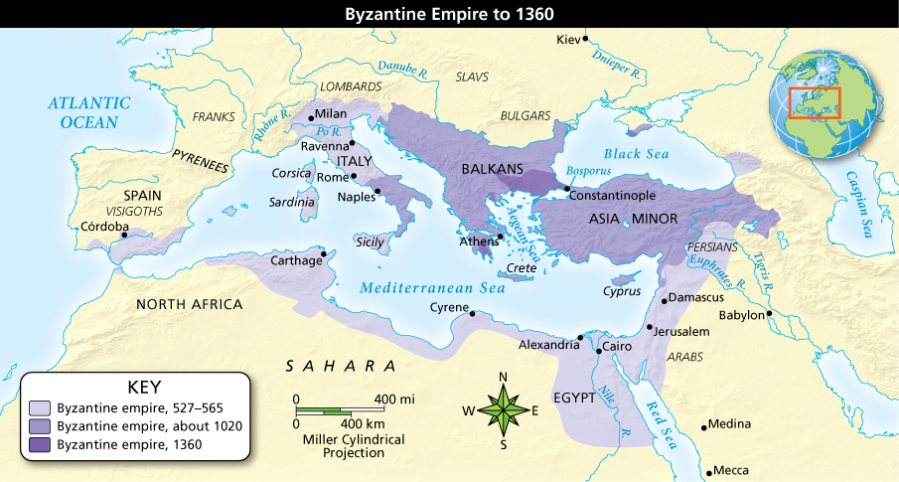
The Age of Justinian
The Byzantine empire reached its greatest size by 565. Analyze Maps Describe the Byzantine empire's extent in 1020. Infer What does the empire's size in 565 suggest about Justinian’s rule?

Slide 13
Changes in Western Europe
In Europe, the centuries after the fall of Rome are called the Middle Ages, which lasted from about 500 to 1350.
The Middle Ages refers to the time between the ancient and modern worlds.
During this long stretch of time, Western Europe passed through two distinct phases: the early Middle Ages, lasting from about 500 to 1050, and the late Middle Ages, lasting from about 1050 to 1350.
A Shift to the North
Power leaves the Mediterranean and heads to Western Europe
Western Europe has great potential because of resources
A Time of Decline:
Learning, and trade decline
Population loss due to wars and loss of civilization

Slide 14
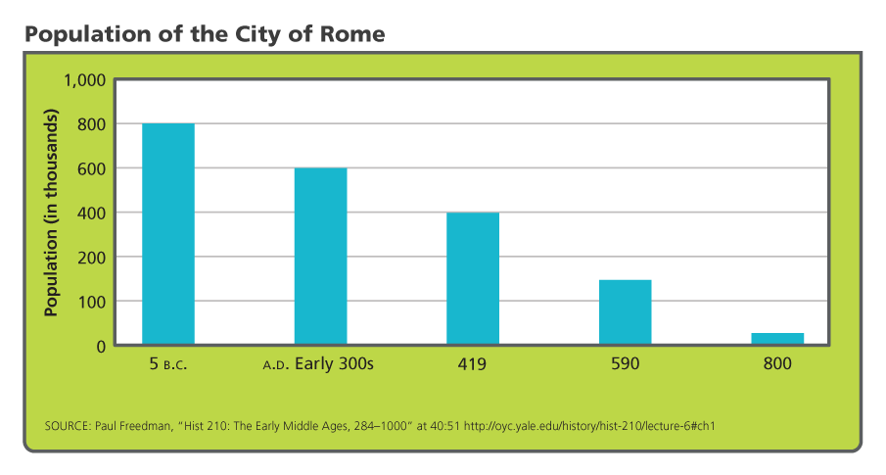
Changes in Western Europe
Analyze Graphs When does Rome's greatest population drop in thousands occur? the greatest percentage drop? Draw Conclusions What does the information in this graph tell you?

Slide 15
Germanic Kingdoms
The Germanic tribes that conquered parts of the Roman empire included the Goths, Vandals, Saxons, and Franks.
Their culture was very different from that of the Romans.
They were mostly farmers and herders, so they had no cities or written laws.
Instead, they lived in small communities governed by unwritten customs.
Their kings were elected leaders, chosen by tribal counsels.
Warriors swore loyalty to the king in exchange for weapons and a share in the plunder taken from defeated enemies.
Between 400 and 700, these Germanic tribes carved Western Europe into small kingdoms.

Slide 16
Germanic Kingdoms
The Kingdom of the Franks
In 486 Clovis, King of the Franks, conquered the former Roman province of Gaul
He tried to preserve much of the Roman legacy
He converted to Christianity in order to gain support of his people and the Pope
Muslim Armies Advance Into Europe
Islam is founded as a religion in 622 and in the next 200 years create a very large empire.
They take over North Africa, Palestine, and Spain all Christian Kingdoms
They advance into France where they are defeated by Charles Martel at Tours in 732
They still hold Spain and are distrusted by the Christians even though Muslims share knowledge about Science and Math with the Europeans.

Slide 17
Germanic Kingdoms
King Clovis of the Franks rallies his warriors during one of many battles he fought to build his kingdom. His conversion to Christianity set an example for other Germanic rulers.

Slide 18
Charlemagne Builds an Empire
In 768 Charlemagne, or Charles the Great, the grandson of Charles Martel became king of the Franks.
He built an empire reaching across what is now France, Germany, and part of Italy.
Emperor of the Romans
799 Pope Leo III asked for his help against rebellious Roman nobles
He helped and was proclaimed Emperor
Brought the idea of a United Christian community called Christendom
Outraged the Byzantine Emperor who saw himself as he Roman Emperor
Started the struggle between German Emperors and Popes in later years

Slide 19
Charlemagne Builds an Empire
Creating a Unified Christian Empire
Working with the Church, Charles will use missionaries to convert his subjects.
He will use nobles to rule and send officials named missi dominici to keep an eye on the nobles and administer law
Charlemagne Revives Latin Learning
Charlemagne will set up a palace school and send for scholars from all over to educate officials
He used education to strengthen his empire with the use of records and clear reports
Charlemagne's Legacy
Even though his expire will crumble Charles will extend Christian civilization to Northern Europe.
He will also set up a strong efficient government that later rulers will look to his empire as an example to strengthen their own.

Slide 20
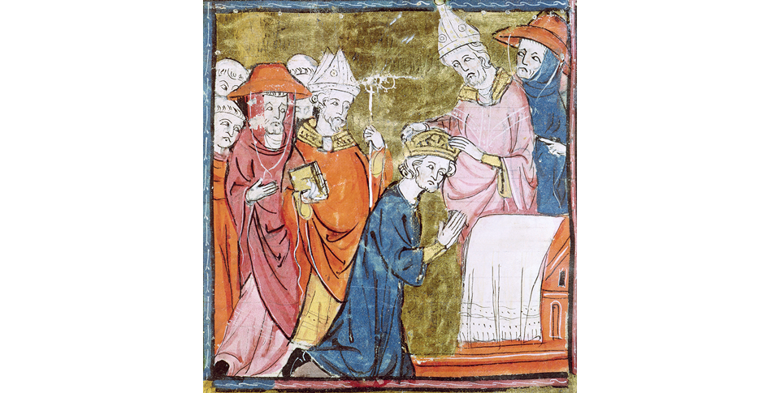
Charlemagne Builds an Empire
In this medieval illustration, Pope Leo III crowns a kneeling Charlemagne Emperor of the Romans in 800 before an assembly of concerned churchmen. Explain why did this event cause controversy?

Slide 21
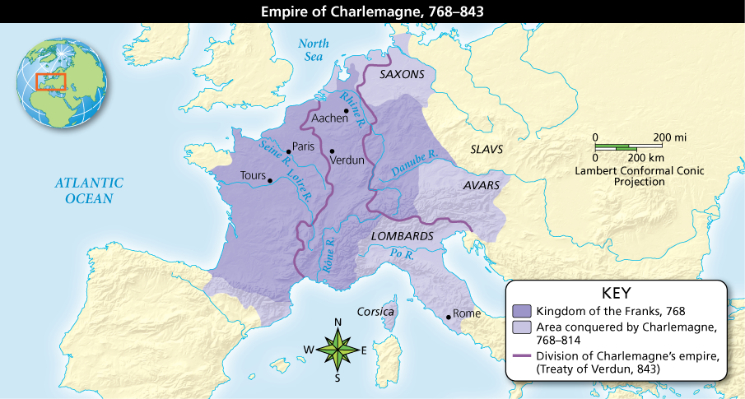
Charlemagne Builds an Empire
Charlemagne built an empire his descendants could not hold together.Locate Charlemagne's empire in 814. Predict Consequences What might be one result of the division of his empire? Explain.

Slide 22
New Invasions Pound Europe
After Charlemagne died in 814, his son Louis I took the throne.
Later, Louis’s sons battled for power.
Finally, in 843, Charlemagne’s grandsons drew up the Treaty of Verdun, which split the empire into three regions.
The empire was divided just at a time when these lands were faced with new waves of invasions.
Three Sources of Attack
Muslims attacking from the South
Magyars attack from Hungary
Vikings attack from Scandinavia
Viking Raids from the North
Amazing sailors and ferocious fighters
Traders and explorers
Established colonies from Russia all the way to the Mediterranean and North America

Slide 23
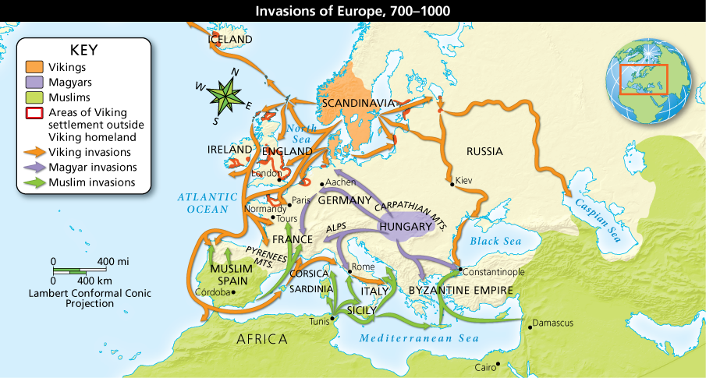
New Invasions Pound Europe
Analyze Maps Use the map to find total distances the invaders traveled and number of routes taken. Rank the invaders from longest to shortest total distances traveled and most to least routes taken.

Slide 24
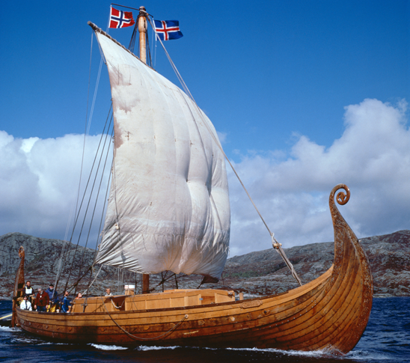
New Invasions Pound Europe
This is a modern replica of a Viking ship built around 820 and found buried in western Norway in 1903. Thirty oarsmen, a lookout, and man at the tiller would have sailed that ship.

